Slide 1
Algorithmic Workshop

Slide 2
The Algorithm
An Algorithm is a sequence of steps to solve a problem.
An algorithm is a set of instructions designed to perform a specific task.
This can be a simple task (multiplying two numbers) or a complex task (video compression)
Each search engine (such as Google) has its own "algorithm" that ranks websites for each keyword or combination of keywords (in milliseconds , seconds or in minutes)
The word algorithm is derived from the last name of Muhamed ibn Musa Al-Khwarizmi

Slide 3
Learning Outcomes from the course
Skills | Learning Outcomes
To Design an algorithm | Design an algorithm in a language-independent way
 | Implement efficiently an algorithm in Python
To Understand complexity | Evaluate the time needed for a given algorithm to complete
 | Evaluate the memory needed for a given algorithm to complete
 | Compute or Find the complexity (space and time) of an algorithm
To Choose the best algorithm & Demonstrate a familiarity with major algorithms | Decide whether it is worth coding this algorithm or find another, more performant
 | Comparing different algorithms to solve a problem
Apply important algorithmic design paradigms | Describe the Divide-And-Conquer paradigm and explain when an algorithmic design situation calls for it.
 | Describe the Dynamic-Programming paradigm and explain when an algorithmic design situation calls for it.
 | Describe the Greedy paradigm and explain when an algorithmic design situation calls for it.
 | Explain what an approximation algorithm is, and the benefit of using approximation algorithms. Be familiar with some approximation algorithms
 | Explain the different ways to design a randomized algorithm
Graph algorithms | Explain the major graph algorithms and their analyses.
 | Design specific algorithms on sparse very large graphs.

Slide 4
Introduction
Factors that affects program performance:
Hardware
Compilers
Programming Language
Operating Systems
Data structures
Algorithms

Slide 5
Algorithm design and algorithm analysis
Algorithm Design is a specific instructions for completing a task.
“algorithms design are patterns for completing a task in an efficient way.”
Algorithms Analysis is the determination of the amount of resources (such as time and storage) necessary to execute the algorithm.
“usually described as (time complexity) and (space complexity) of an algorithm”

Slide 6
(time complexity) and (space complexity)
Time complexity is a function describing the amount of time an algorithm takes in terms of the amount of input to the algorithm
Space complexity is a function describing the amount of memory (space) an algorithm takes in terms of the amount of input to the algorithm
Big O notation is the most common metric for calculating time complexity.

Slide 7
Time Complexity (Big O notation)
Big O notation describes the execution time of the algorithm in relation to the number of steps required to complete it.
Usually is the worst case running time of an algorithm
Used in computer science in the analysis of algorithms complexity

Slide 8
How To Evaluate Efficiency of Programs
GOAL: to evaluate different algorithms
Measure with a timer
Count the operations
Edx-MIT: Introduction_to_Computer_Science_and_Programming_Using_Python

Slide 9
Measure with a timer(1)
import time
t0 = time.clock()
sum=0
for i in range(10000000):
sum+=i
t1 = time.clock() -t0
print("Time of Running : ",t1)
import time
use time module
importing means to bring in that class into your own file
t0 = time.clock()
Startclock
for i in range(10000000):
Loop
Running time varies implementation (Programming Languages)
Running time varies between computers

Slide 10
Counting Operations(2)
Assume these steps take constant time:
mathematical operations
comparisons
assignments
accessing objects in memory

Slide 11
Counting Operations(2)
def mysum(n):
total = 0
for i in range(n+1):
total += i
return total
1 Operation
1 Operation(n times)
2 Operation(n times)
Total operations (1+3n) operation

Slide 12
What is the number of steps in the worst case?
def program1(n):
total = 0
for i in range(1000):
total += i
while n > 0:
n -= 1
total += n
return total
In the worst case scenario, n is a large positive number.
We first execute the assignment total = 0
for i in range(1000) loop. This loop is executed 1000 times and has three steps
one for the assignment of i each time through the loop
two for the += operation on each iteration.
the second loop (while n > 0) n times. This loop has five step
conditional check, n > 0
and two each for the -= and += When we finally get to the point where n = 0.
We next check if n > 0 - it is not so we do not enter the loop.
Adding one more step for the return statement.
in the worst case = 5*n + 3003 steps.
1
1000
2000
1n+1
2n
2n
1
5n+3003
Complexity=O(n)
Edx-MIT: Introduction_to_Computer_Science_and_Programming_Using_Python

Slide 13
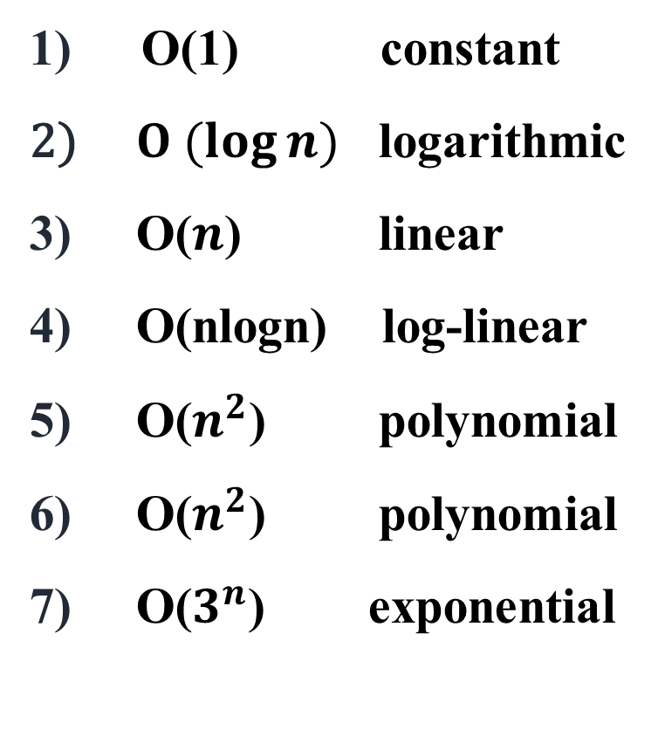
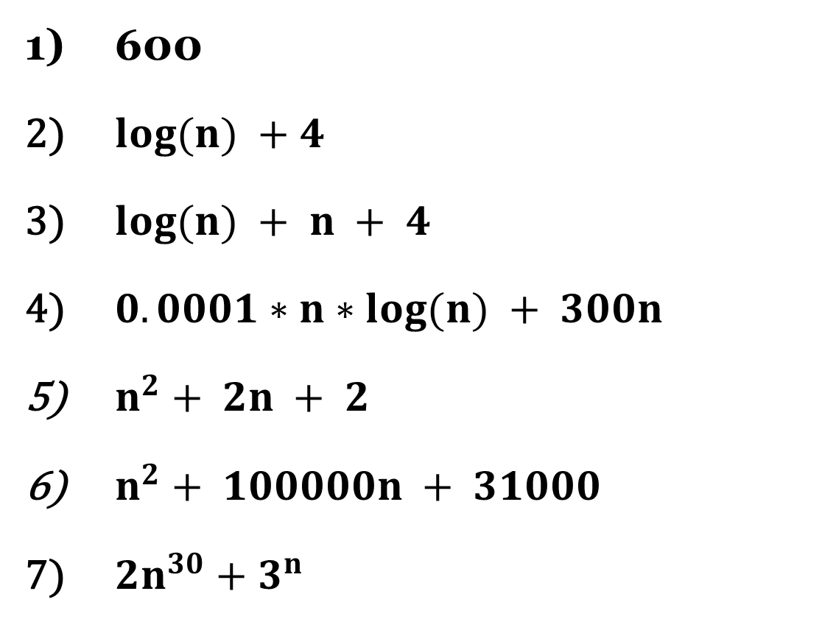
Big O notation
600
$log⁡(n) +4$
$log⁡(n) + n + 4$
$0.0001∗n∗log⁡(n) + 300n$
$n^{2}+ 2n + 2$
$n^{2}+ 100000n + 31000$
$2n^{30}+3^{n}$
O(1) constant
$O (log⁡n)$ logarithmic
O($n$) linear
O(nlogn) log-linear
O($n^{2}$) polynomial
O($n^{2}$) polynomial
O($3^{n}$) exponential

Slide 14
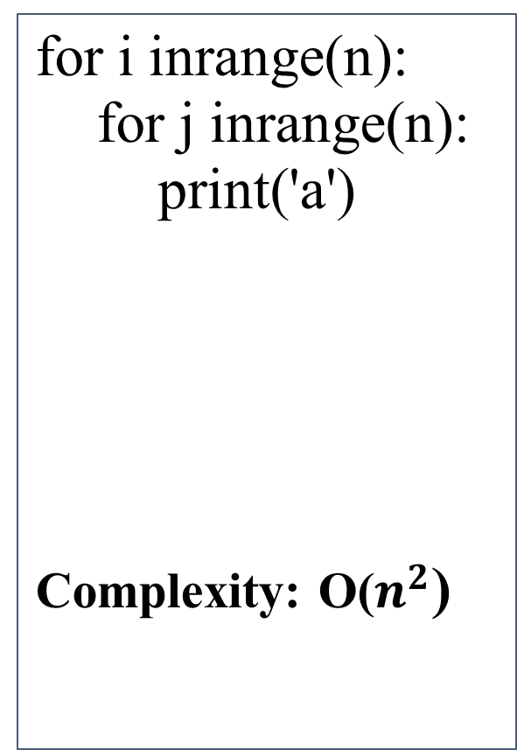
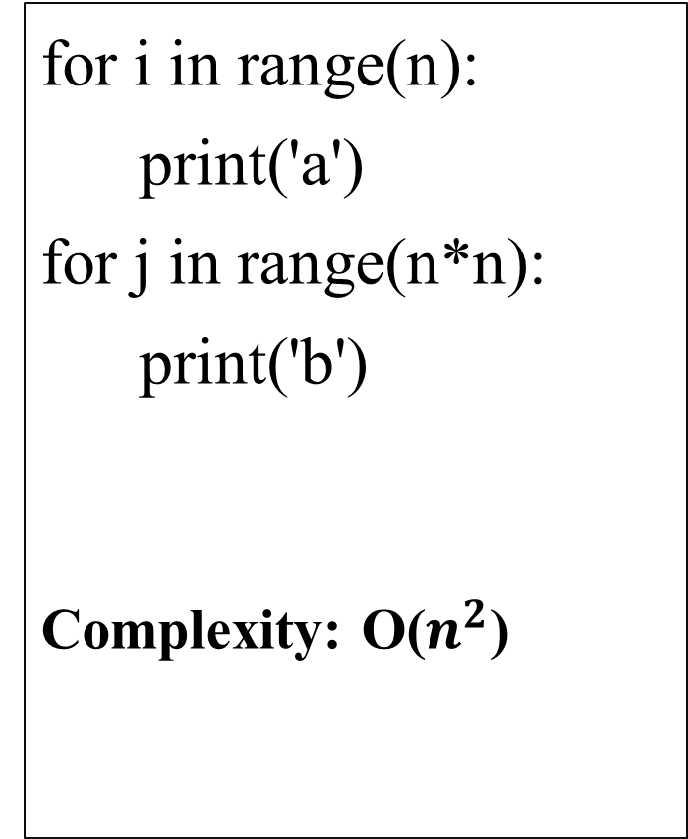
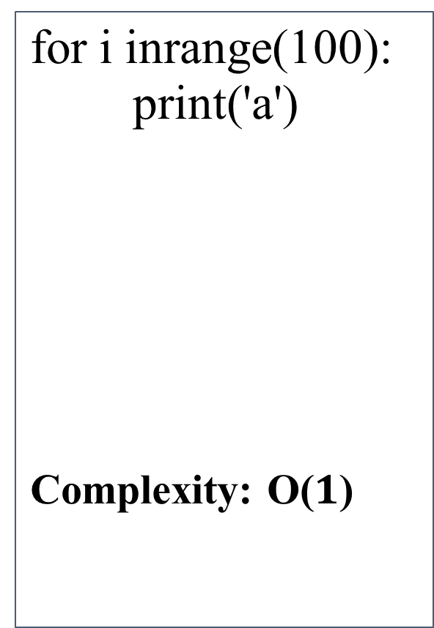
Big O notation
for i in range(n):
print('a')
for j in range(n*n):
print('b')
Complexity: O($n^{2}$)
for i inrange(n):
for j inrange(n):
print('a')
Complexity: O($n^{2}$)
for i inrange(100):
print('a')
Complexity: O($1$)

Slide 15
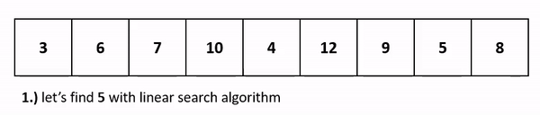
Linear Search
https://ramnauth.github.io/cs%20101/2018/10/17/sorting-searching/

Slide 16

Motivation (Binary Search)

Slide 17
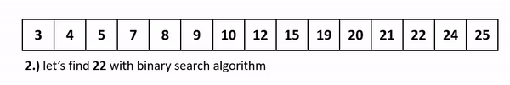
Binary Search
https://ramnauth.github.io/cs%20101/2018/10/17/sorting-searching/

Slide 18
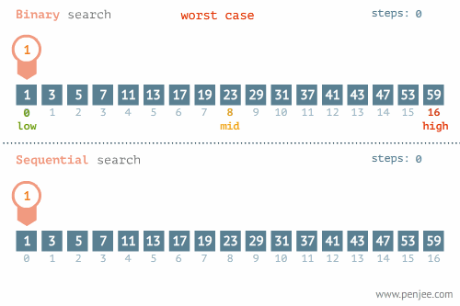
Linear vs Binary Search (worst case)
https://blog.penjee.com/binary-vs-linear-search-animated-gifs/

Slide 19
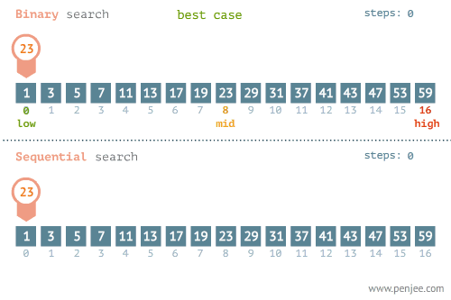
Linear vs Binary Search (best case)
https://blog.penjee.com/binary-vs-linear-search-animated-gifs/

Slide 20

Linear vs Binary Search
Choose One:
Linear Search
Binary Search(Sort the array)
Linear Search Big O notation is O(n)
Binary Search Big O notation is O(log N)

Slide 21
Comparison of N, logN and N²
N O(LogN) O(N²)
16 4 256
64 6 4K
256 8 64K
1,024 10 1M
16,384 14 256M
131,072 17 16G
262,144 18 6.87E+10
524,288 19 2.74E+11
1,048,576 20 1.09E+12
1,073,741,824 30 1.15E+18

Slide 22
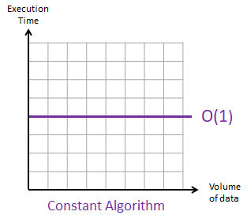
Example on Constant Notation: O(1)
The constant notation describes an algorithm that will always execute in the same execution time regardless of the size of the data set.
For instance, an algorithm to retrieve the first value of a data set, will always be completed in one step, regardless of the number of values in the data set.
FUNCTION getFirstElemnt(list)
RETURN list[0]
END FUNCTION

Slide 23
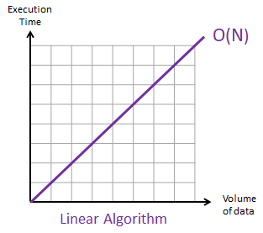
Example on Linear Notation: O(N)
A linear algorithm is used when the execution time of an algorithm grows in direct proportion to the size of the data set it is processing.
Algorithms, such as the linear search.
FUNCTION linearSearch(list, value)
FOR EACH element IN list
{ IF (element == value)
RETURN true
}
RETURN false
END FUNCTION

Slide 24
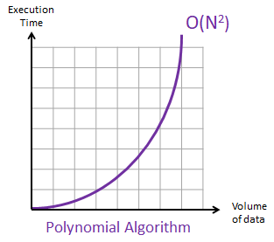
Example on Polynomial Notation: O(N²), O(N³), etc.
O(N²) when the complexity of the algorithm proportional to the square of the size of the data set.
O(N³) when the complexity of the algorithm proportional to the cube of the size of the data set.
Algorithms which are based on nested loops
PROCEDURE displayTimesTable()
FOR i FROM 1 TO 10
FOR j FROM 1 TO 10
product = i*j
OUTPUT i + " times " + j + " equals " + product
NEXT j
NEXT i
END PROCEDURE

Slide 25
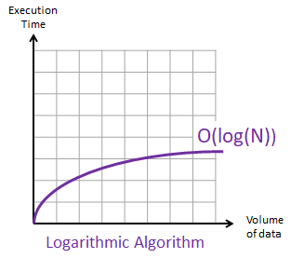
Example on Logarithmic Notation: O(log(N))
A binary search is a typical example of logarithmic algorithm.
In a binary search, half of the data set is discarded after each iteration. Which means that an algorithm which searches through 2,000,000 values will just need one more iteration to search in 1,000,000 values only then in 500,000 then in 250,000 then in 125,000 (in 4 iterations only )and so on.

Slide 26
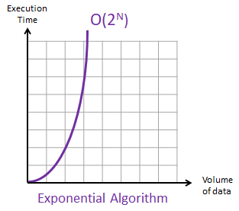
Example on Exponential Notation: O(2^{n})
The exponential notation O(2^{N}) describes an algorithm whose growth doubles with each addition to the data set.
Example of exponential algorithm: An algorithm to list all the possible binary permutations depending on the number of bits.
2 bits => 4 permutations (2^2)
[0, 0]
[1, 0]
……. 4 bits => 16 permutations (2^4)
[0, 0, 0, 0]
[1, 0, 0, 0]

Slide 27
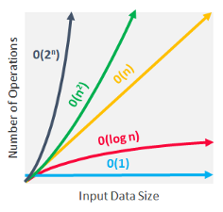

Slide 28
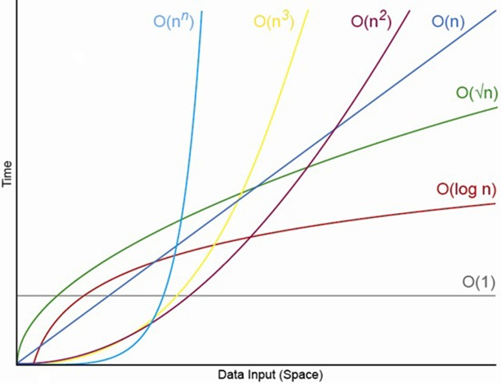

Slide 29
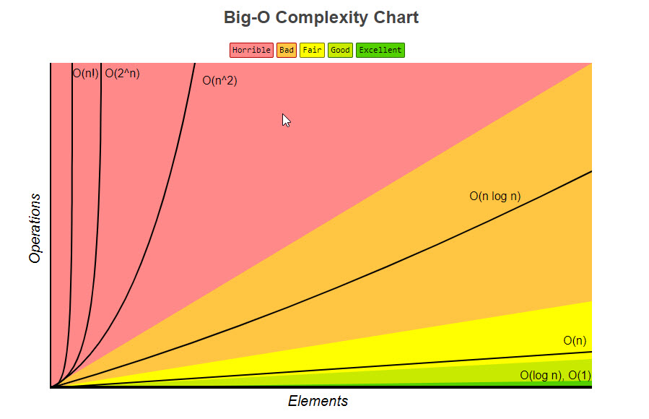

Slide 30
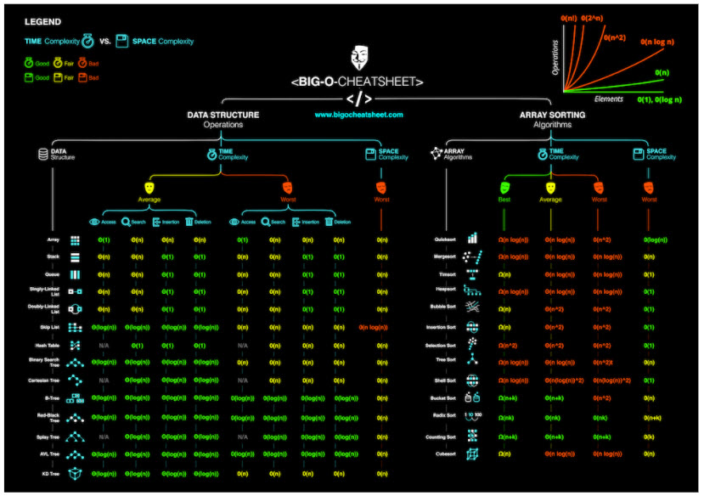
Ref: https://www.bigocheatsheet.com/

Slide 31
Questions
What about big O notation with (Hard) Real time Systems algorithms ?
The big O notation is valid with Machine learning and Deep learning algorithms ?

Slide 32
Recursive Factorial
C++
int fact (int x){
if (x == 0){
return 1;
} else
return n * fact(n – 1);
}
}
Prove, using induction that the algorithm returns the values
fact(0) = 0! =1
fact(n) = n! = n * (n – 1) * … * 1 if n > 0

Slide 33
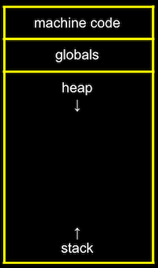
Memory layout

Slide 34
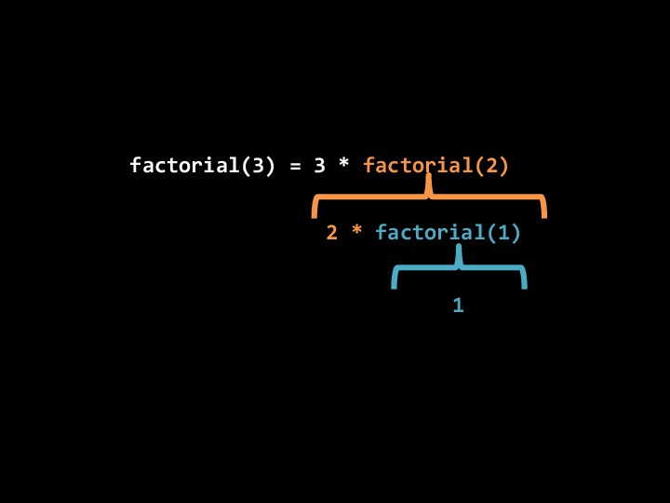

Slide 35
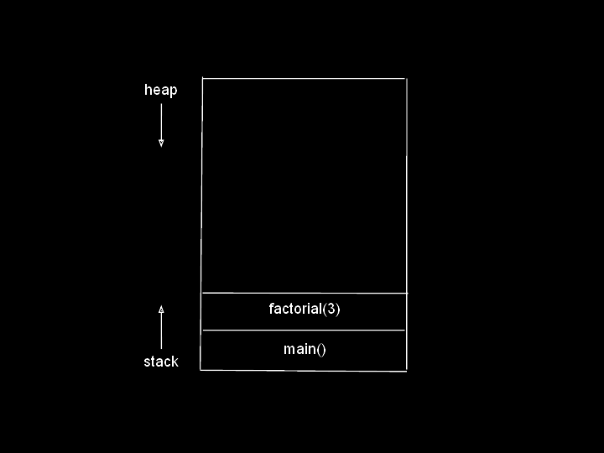

Slide 36
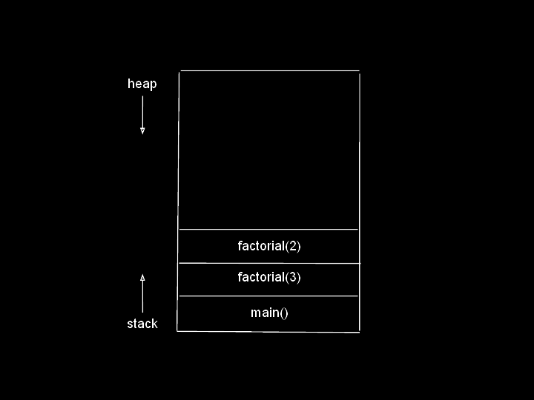

Slide 37
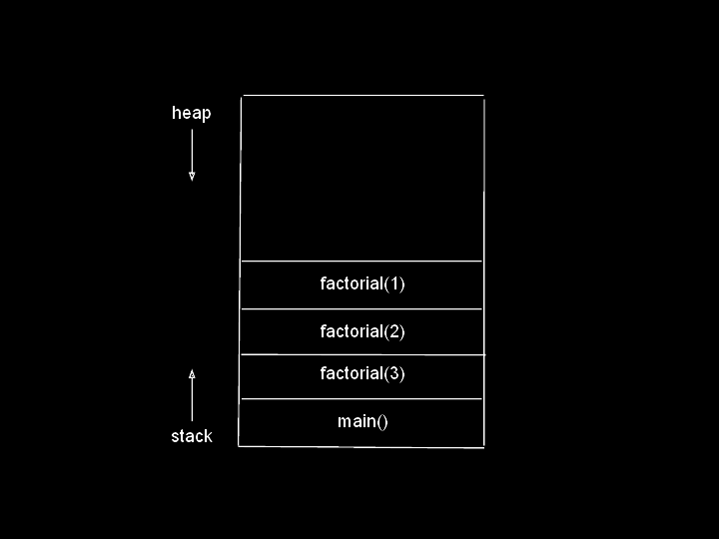

Slide 38
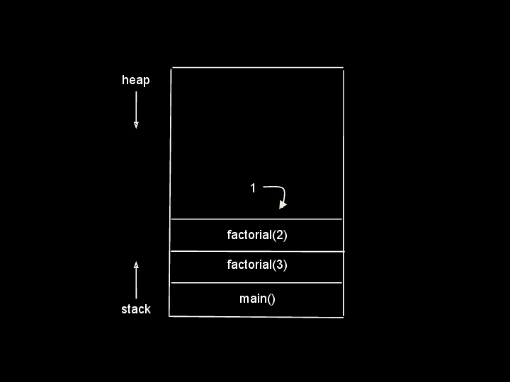

Slide 39
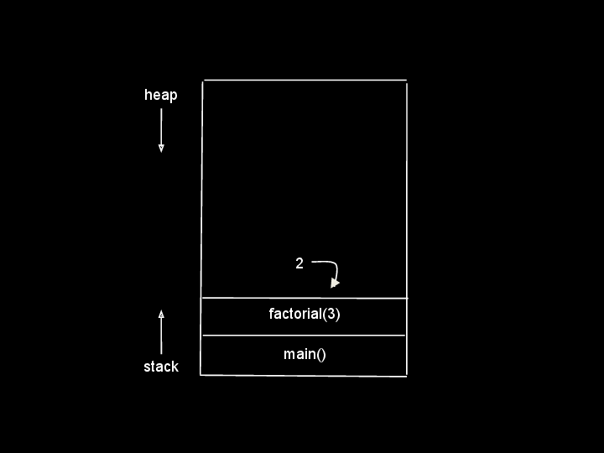

Slide 40
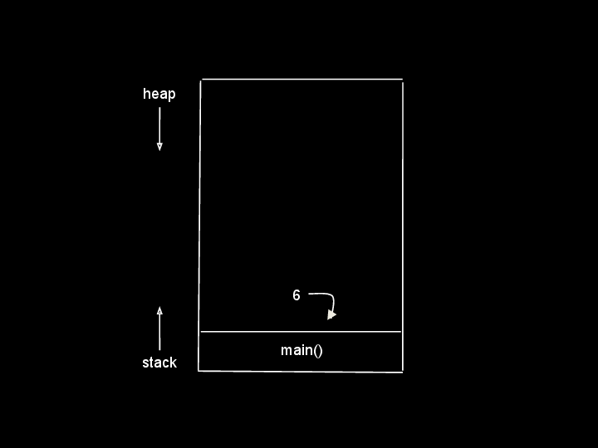

Slide 41

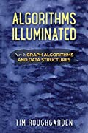
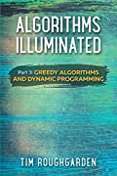
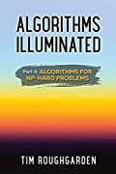
Textbooks
Algorithms Illuminated , Tim Roughgarden:
Part 1: The Basics (September 2017).
Part 2: Graph Algorithms and Data Structures (August 2018)
Part 3: Greedy Algorithms and Dynamic Programming (May 2019)
Part 4: Algorithms for NP-Hard Problems (July 16, 2020)
http://algorithmsilluminated.org/

Slide 42
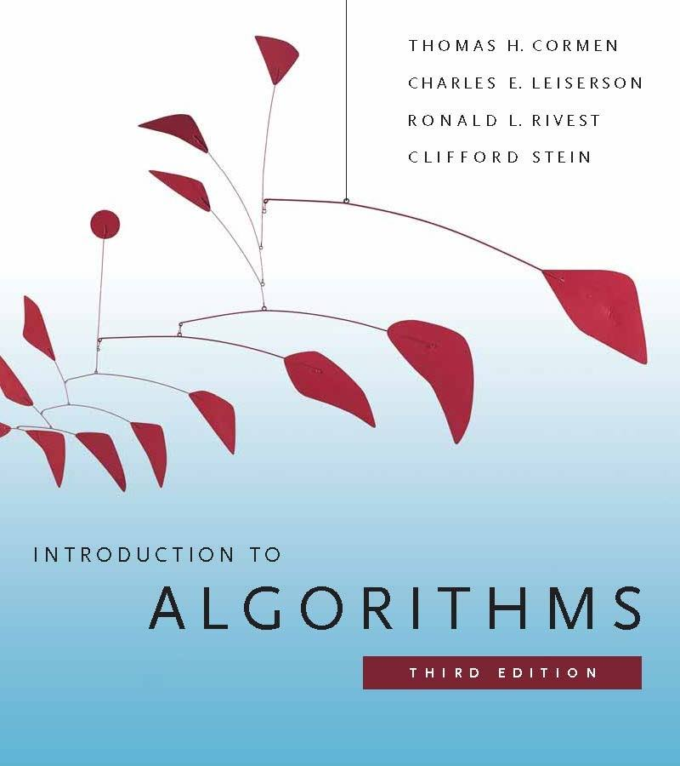
Reference
Introduction to Algorithms
3rd edition
By: Thomas H. Cormen,
Charles E. Leiserson,
Ronald L. Rivest,
Clifford Stein
Published by The MIT Press, 2009

Slide 43
Recommended Video Lectures
MIT
“Introduction to Algorithms”
Prof. Erik Demaine,Prof. Srini Devadas
https://ocw.mit.edu/courses/electrical-engineering-and-computer-science/6-006-introduction-to-algorithms-fall-2011/
2) MIT
“Introduction to Algorithms”
Prof. Charles Leiserson
https://ocw.mit.edu/courses/electrical-engineering-and-computer-science/6-046j-introduction-to-algorithms-sma-5503-fall-2005/
3) Stanford-Coursera
“Algorithm Specialization”
Tim Roughgarden
https://www.coursera.org/specializations/algorithms

Slide 44
Recommended Video Lectures
4) UC San Diego and National Research University.
“Data Structures and Algorithms Specialization”
https://www.edx.org/micromasters/ucsandiegox-algorithms-and-data-structures
https://www.coursera.org/specializations/data-structures-algorithms
5) Ghassan Shobaki Computer Science Lectures
https://www.youtube.com/playlist?list=PL6KMWPQP_DM8t5pQmuLlarpmVc47DVXWd

